Slide 1
VICHARA PARTNERS
Navigating the Complex World of Product Compliance:
Practical Advice from the Field
Supply Chain Insight November 20, 2019 (Phoenix, AZ, USA)

Slide 2
Complex Products, Complex Challenges

Slide 3
Presentation Goals: Advice & Perspective
Stakeholder Engagement
Narrow Focus
Reactive
Limited Options
Isolated
Holistic & Strategic
Proactive
Many Options
Part of Team

Slide 4
Framework for Evaluating & Addressing Risk
Value Your Own Expertise
Identify Drivers Motivating Change
Conduct Research on Specific Issue
Have an Internal Discussion
Arrive at a Solution
Reinforce/Strengthen Relationships
Adopt Changes

Slide 5
Framework for Evaluating & Addressing Risk
Value Your Own Expertise
Identify Drivers Motivating Change
Conduct Research on Specific Issue
Have an Internal Discussion
Arrive at a Solution
Reinforce/Strengthen Relationships
Adopt Changes
Notes:
NIKOLE – FOUNDATION OF ALL OF YOUR COMPANY’S WORK STARTS WITH YOU

Slide 6
Types of Motivational Drivers
Technological Innovations
Business-Related Contractual Obligations
Regulatory Mandates
Legal Liability
Pressure from Institutional Investors
Reputation and Brand
Societal Demands

Slide 7
Factors Affecting Corporate Sensitivity
Geographic Location
Position in Value Chain
Historic Legacy
Corporate Culture
Size of Company
Ability to Address Drivers

Slide 8
Stakeholders Demanding / Requesting Changes
Shareholders
Internal Corporate Departments
Customer Chains
Supply Chains
Industry Associations
Government Agencies
Local Communities
Advocacy Groups

Slide 9
Specific Mechanisms Used to Drive Change
Investigation and Due Diligence
Public Reporting
Exposure Limits and Emission Controls
Substitution Guidance
Permission to Use Requirements
Substance Bans

Slide 10
Framework for Evaluating & Addressing Risk
Value Your Own Expertise
Identify Drivers Motivating Change
Conduct Research on Specific Issue
Have an Internal Discussion
Arrive at a Solution
Reinforce/Strengthen Relationships
Adopt Changes

Slide 11
Conduct Research: Material Content Regulation Example
Learn about Restrictions & Mandates
Consider Whether Restrictions Apply
Identify Materials Used in Manufacturing and Contained in your Product
Consider Impact of Material Restrictions on Product Performance

Slide 12
Identify Materials
Questions to Consider:
What is your product?
How is your product made?
How is your product used?

Slide 13
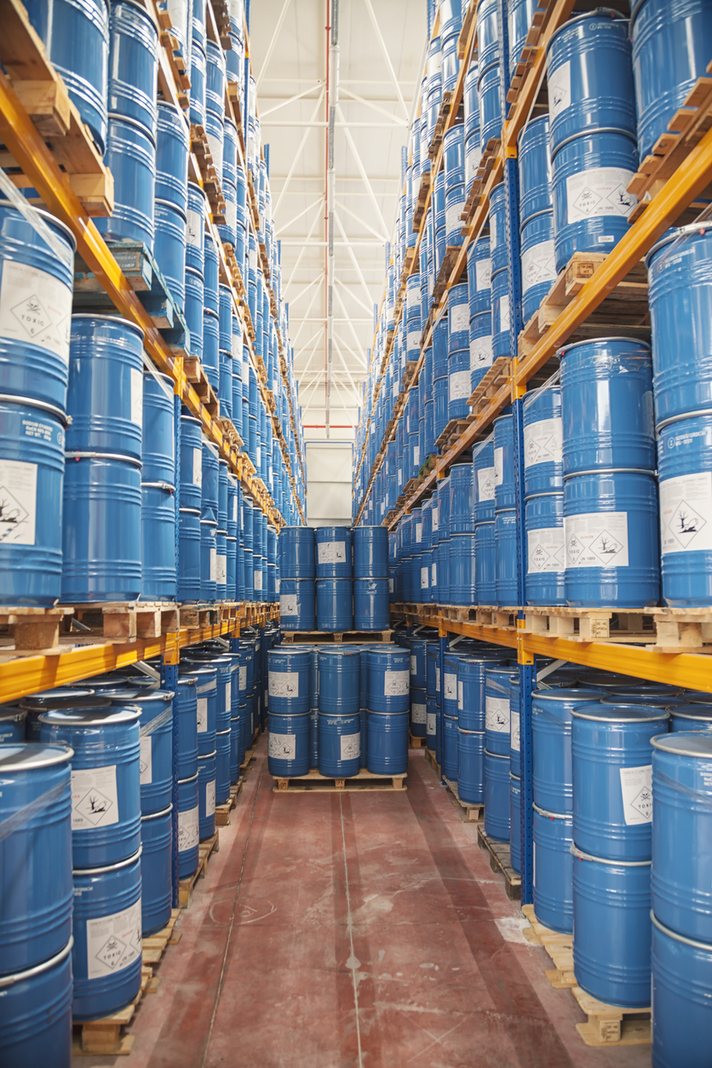
Understanding the Scope of Materials Used
Materials of Construction
Process Materials
Support Materials
Contaminants & By-Products
PRODUCT

Slide 14
Vichara Industry Map: Electronics Industry Example
MATERIALS
OBJECTS
SYSTEMS
EXTRACTION
COMPONENTS
SIMPLE SYSTEMS
SUBSTANCES
ASSEMBLIES
NETWORKED SYSTEMS
MIXTURES
PRODUCTS
SUPER SYSTEMS

Slide 15
Specialized Corporate Roles

Slide 16
Vichara Industry Map: Electronics Industry Example
MATERIALS
OBJECTS
SYSTEMS
EXTRACTION
COMPONENTS
SIMPLE SYSTEMS
SUBSTANCES
ASSEMBLIES
NETWORKED SYSTEMS
MIXTURES
PRODUCTS
SUPER SYSTEMS

Slide 17
Potential Impact of Material Regulations
Changes in Manufacturing Processes
Changes in Product Performance
Customers Require Requalification
Chemical Substitutions Result in Additional Hazard
Replacement Chemical/Material Equally (or More) Hazardous
Future Regulation of Replacement

Slide 18
Framework for Evaluating & Addressing Risk
Value Your Own Expertise
Identify Drivers Motivating Change
Conduct Research on Specific Issue
Have an Internal Discussion
Arrive at a Solution
Reinforce/Strengthen Relationships
Adopt Changes

Slide 19
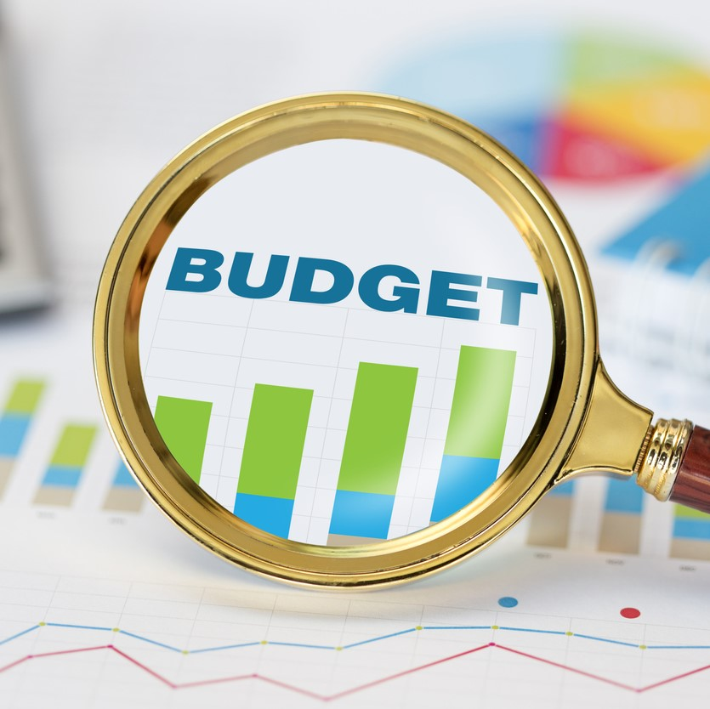
Identify Stakeholders for an Internal Discussion
DESIGN
ENGINEERING
PROCUREMENT
SAFETY
ENVIRONMENTAL
OPERATIONS
GOVERNMENT RELATIONS
FINANCE
MARKETING
CUSTOMER SERVICE

Slide 20
Framework for Evaluating & Addressing Risk
Value Your Own Expertise
Identify Drivers Motivating Change
Conduct Research on Specific Issue
Have an Internal Discussion
Arrive at a Solution
Reinforce/Strengthen Relationships
Adopt Changes
Notes:
…

Slide 21
Arrive at a Solution
Do Nothing
Compliance Request
Stakeholder Engagement
Consider Implications of New Compliance Plan Carefully
Different Solutions Carry Different Levels of Risk
Adjustments to Safety Protocols Require Training/New Behaviors
Be Aware of Future Regulations/Restrictions

Slide 22
Framework for Evaluating & Addressing Risk
Value Your Own Expertise
Identify Drivers Motivating Change
Conduct Research on Specific Issue
Have an Internal Discussion
Arrive at a Solution
Reinforce/Strengthen Relationships
Adopt Changes
Notes:
…

Slide 23
Relationships With External Stakeholders
GOVERNMENTS
VALUE CHAIN
CUSTOMER CHAINS
SUPPLY CHAINS
CUSTOMERS
SUPPLIERS
YOUR BUSINESS
ADVOCACY GROUPS

Slide 24
Benefits of Strong Stakeholder Relationships
Strong stakeholder relationships make your organization more effective, efficient, profitable and sustainable by providing you with the ability to:
Adapt to Risk within Your Supply Chain
Anticipate Customer Needs
Shape Government Regulations & Policy
Become a Trusted Community Partner
Strengthen your Brand/Reputation

Slide 25
Framework for Evaluating & Addressing Risk
Value Your Own Expertise
Identify Drivers Motivating Change
Conduct Research on Specific Issue
Have an Internal Discussion
Arrive at a Solution
Reinforce/Strengthen Relationships
Adopt Changes

Slide 26
Our Gift to You
A FREE one hour consultation for the FIRST 20 people to schedule:
www.vicharapartners.com/supplychaininsight2019

Slide 27
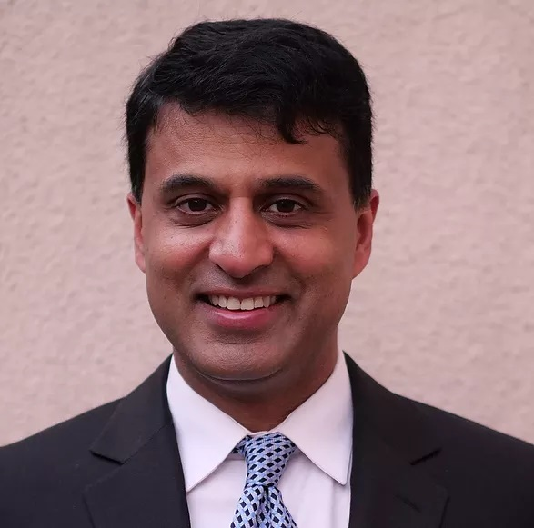
Thank You!
Sanjay Baliga – Founder & Senior Partner
sanjay.baliga@vicharapartners.com | 1.408.515.8529
Nikole Reaksecker – Founder & Senior Partner
nikole@vicharapartners.com | 1.415.205.4051

